Slide 1
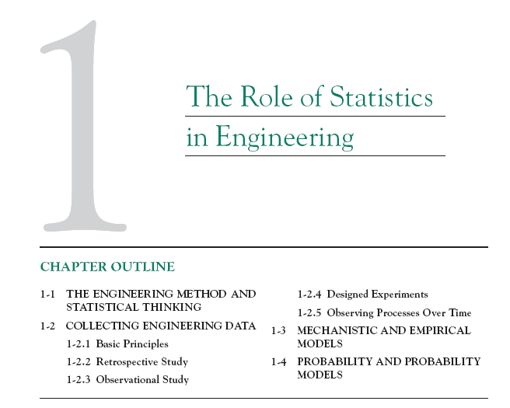

Slide 2
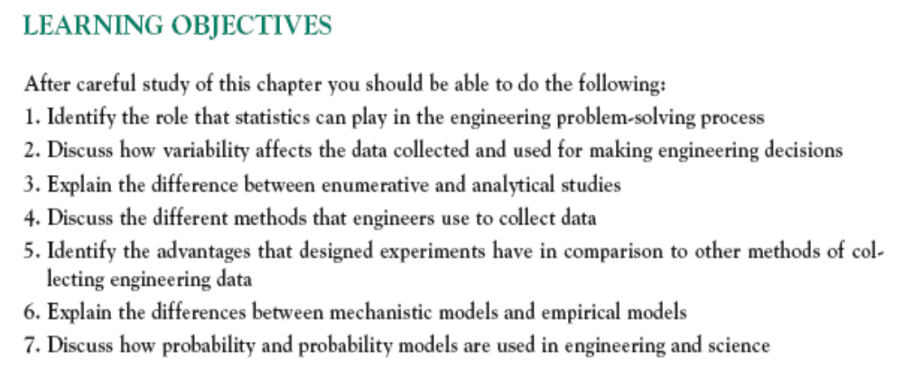

Slide 3
1-1 Statistics in Engineering
An engineer is someone who solves problems of interest to society by the efficient application of scientific principles by
  Refining existing products
  Designing new products or processes

Slide 4
1-1 Statistics in Engineering
The field of Statistics deals with the collection, presentation, analysis, and use of data to
  Make decisions
  Solve problems
  Design products and processes

Slide 5
1-1 Statistics in Engineering
Statistical techniques are useful for describing and understanding variability.
By variability, we mean successive observations of a system or phenomenon do not produce exactly the same result.
Statistics gives us a framework for describing this variability and for learning about potential sources of variability.
Notes:
Phenomenon: hiện tượng

Slide 6
1-1 Statistics in Engineering
Engineering Example
An engineer is designing a nylon connector to be used in an automotive engine application. The engineer is considering establishing the design specification on wall thickness at 3/32 inch but is somewhat uncertain about the effect of this decision on the connector pull-off force. If the pull-off force is too low, the connector may fail when it is installed in an engine. Eight prototype units are produced and their pull-off forces measured (in pounds): 12.6, 12.9, 13.4, 12.3, 13.6, 13.5, 12.6, 13.1.

Slide 7
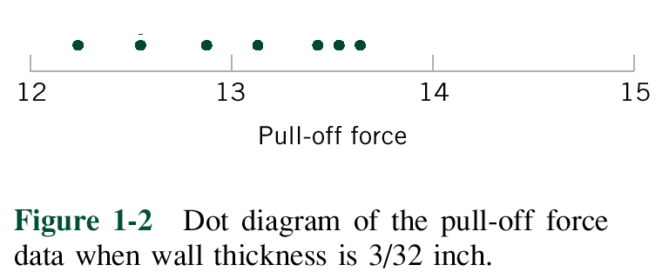
1-1 Statistics in Engineering
Engineering Example
The dot diagram is a very useful plot for displaying a small body of data - say up to about 20 observations.
This plot allows us to see easily two features of the data; the location, or the middle, and the scatter or variability.

Slide 8
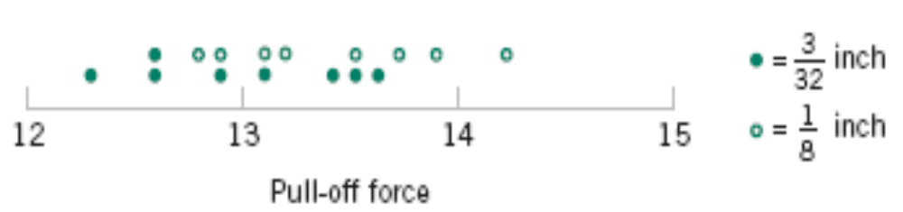
1-1 Statistics in Engineering
Engineering Example
The engineer considers an alternate design and eight prototypes are built and pull-off force measured.
The dot diagram can be used to compare two sets of data
Figure 1-3 Dot diagram of pull-off force for two wall thicknesses.

Slide 9
1-1 Statistics in Engineering
Engineering Example
Since pull-off force varies or exhibits variability, it is a random variable.
A random variable, X, can be modeled by
X = μ + ε
where μ is a constant and ε a random disturbance.

Slide 10
Data
Data
collections of observations (such as measurements, genders, survey responses)
Copyright © 2010, 2007, 2004 Pearson Education, Inc. All Rights Reserved.
Notes:
Response: sự trả lời, câu trả lời

Slide 11
Statistics
Statistics
is the science of planning studies and experiments, obtaining data, and then organizing, summarizing, presenting, analyzing, interpreting, and drawing conclusions based on the data.
statistic
Copyright © 2010, 2007, 2004 Pearson Education, Inc. All Rights Reserved.
Notes:
Interprete: giải thích
statistic

Slide 12
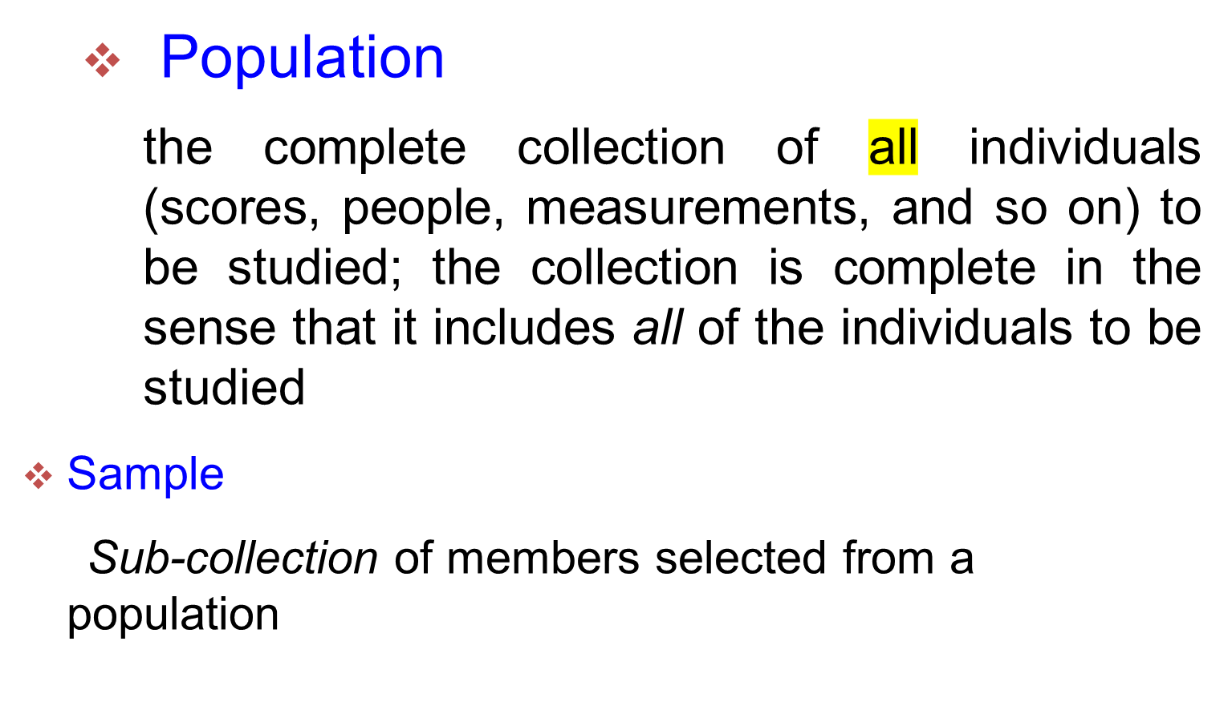
Population & Sample
Copyright © 2010, 2007, 2004 Pearson Education, Inc. All Rights Reserved.

Slide 13
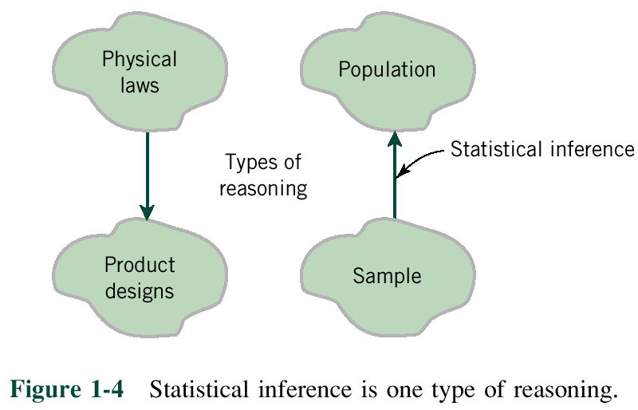
1-1 Statistics in Engineering
Notes:
P=mg

Slide 14
1-2 Collecting Engineering Data
Three basic methods for collecting data:
  A retrospective study using historical data
  An observational study
  A designed experiment

Slide 15
1-2 Collecting Engineering Data
  A retrospective study using historical data
  would use either all or a sample of the historical process data archived over some period of time.

Slide 16
1-2 Collecting Engineering Data
  An observational study: the engineer observes the process or population, disturbing it
Notes:
Disturb: lam nhieu loan

Slide 17
1-2 Collecting Engineering Data
  A designed experiment: the engineer makes deliberate in the controlable variables of the system, observes the resulting system output data

Slide 18
Determine whether the given description corresponds to an observational study or an experiment
1. Physicians at the Mount Sinai Medical Center studied New York City residents with and without respiratory problems. They went back in time to determine how those residents were involved in the terrorist attacks in New York City on September 11, 2001.
2. A Gallup poll surveyed 1018 adults by telephone, and 22% of them reported that they smoked cigarettes within the past week.
3. A study of the effectiveness of echinacea involved 707 cases of upper
respiratory tract infections. Children with 337 of the infections were given echinacea, and children with 370 of the infections were given placebos.
Notes:
Physicians at the Mount Sinai Medical Center studied New York
City residents with and without respiratory problems. They went back in time to determine
how those residents were involved in the terrorist attacks in New York City on September 11,
2001.
Physicians at the Mount Sinai Medical Center plan to study
emergency personnel who worked at the site of the terrorist attacks in New York City on
September 11, 2001. They plan to study these workers from now until several years into the
future.
The Nielsen Media Research Company uses people meters to record the
viewing habits of about 5000 households, and today those meters will be used to determine
the proportion of households tuned to CBS Evening News
University of Toronto researchers studied 699 traffic crashes
involving drivers with cell phones (based on data from “Association Between Cellular-
Telephone Calls and Motor Vehicle Collisions,” by Redelmeier and Tibshirani, New England
Journal of Medicine, Vol. 336, No. 7). They found that cell phone use quadruples the risk of a
collision.
A study funded by the National Center for Complementary and Alternative
Medicine found that echinacea was not an effective treatment for colds in children. The experiment
involved echinacea treatments and placebos, and blinding was used. What is blinding,
and why was it important in this experiment?

Slide 19
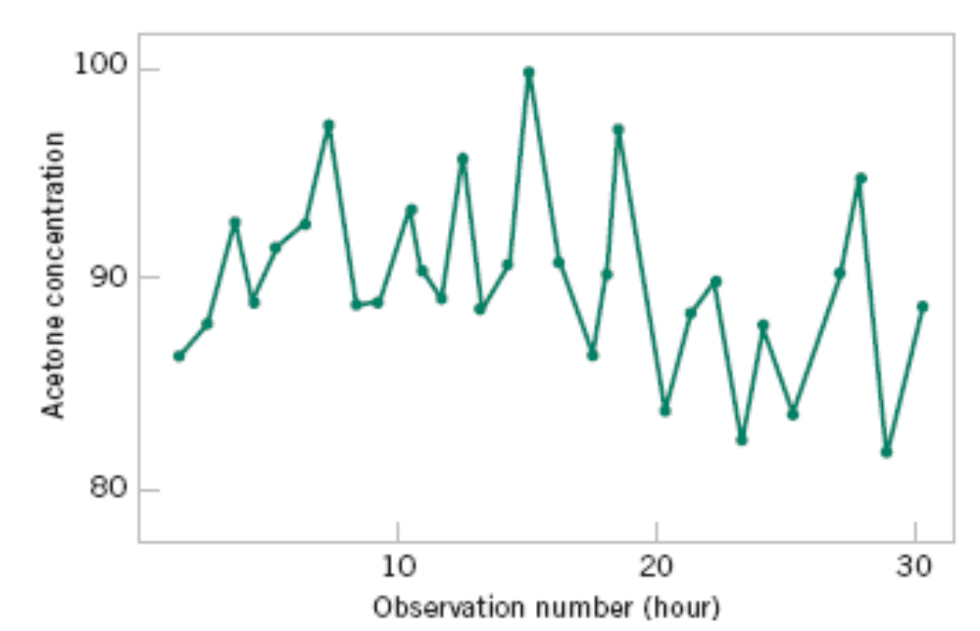
1-2.5 Observing Processes Over Time
Figure 1-9 A time series plot of concentration provides more information than a dot diagram.

Slide 20
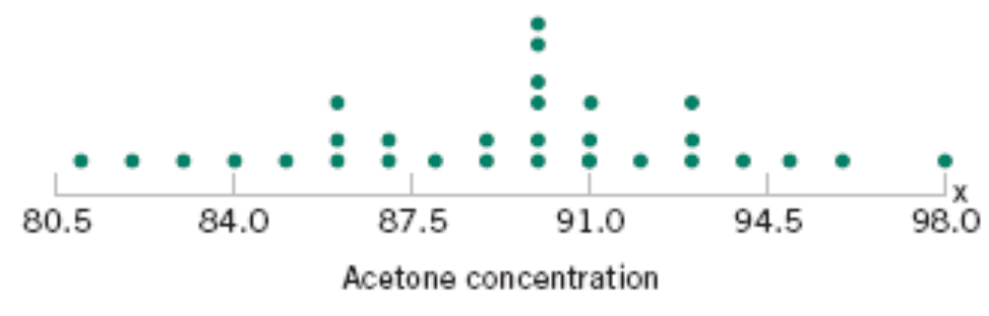
1-2 Observing Processes Over Time
Whenever data are collected over time it is important to plot the data over time. Phenomena that might affect the system or process often become more visible in a time-oriented plot
and the concept of stability can be better judged.
Figure 1-8 The dot diagram illustrates variation but does not identify the problem.

Slide 21
1-3 Mechanistic and Empirical Models
A mechanistic model is built from our underlying knowledge of the basic physical mechanism that relates several variables.
Example: Ohm’s Law
Current = voltage/resistance
I = E/R
I = E/R + ε

Slide 22
1-3 Mechanistic and Empirical Models
An empirical model is built from our engineering and scientific knowledge of the phenomenon, but is not directly developed from our theoretical or first-principles understanding of the underlying mechanism.

Slide 23
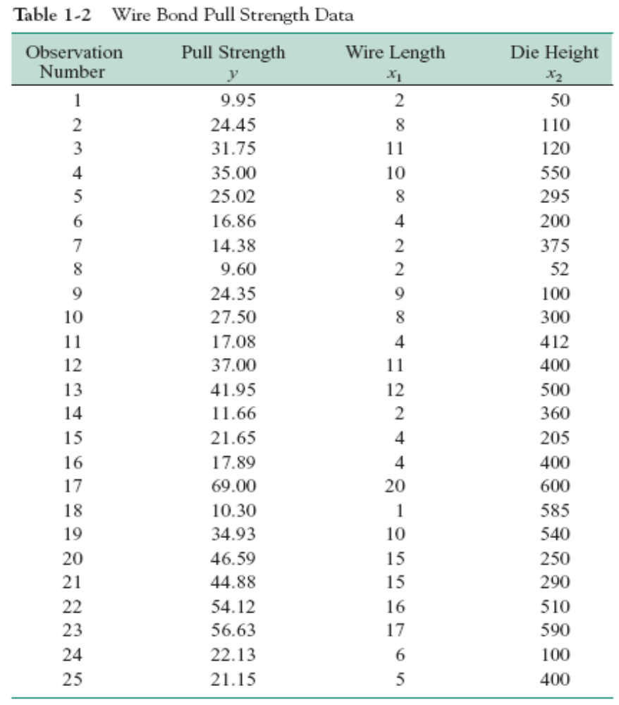

Slide 24
1-3 Mechanistic and Empirical Models
In general, this type of empirical model is called a regression model.
The estimated regression line is given by

Slide 25
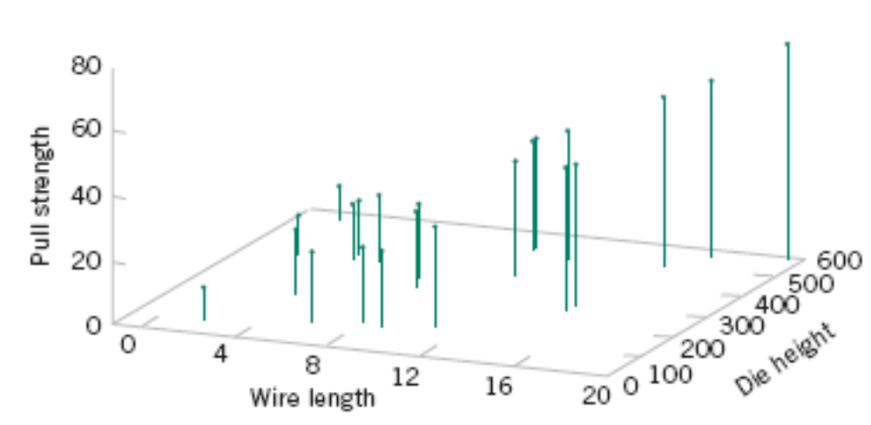
Figure 1-15 Three-dimensional plot of the wire and pull strength data.

Slide 26
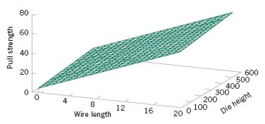
1-4 Probability and Probability Models
Figure 1-16 Plot of the predicted values of pull strength from the empirical model.

Slide 27
1-4 Probability and Probability Models
Probability models help quantify the risks involved in statistical inference, that is, risks involved in decisions made every day.
Probability provides the framework for the study and application of statistics.
Notes:
Quantify: định lượng

Slide 28
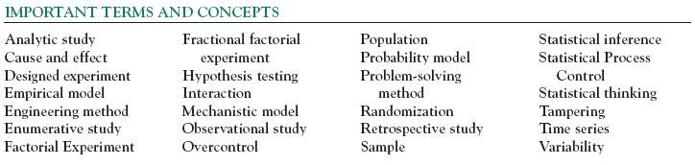

Slide 29

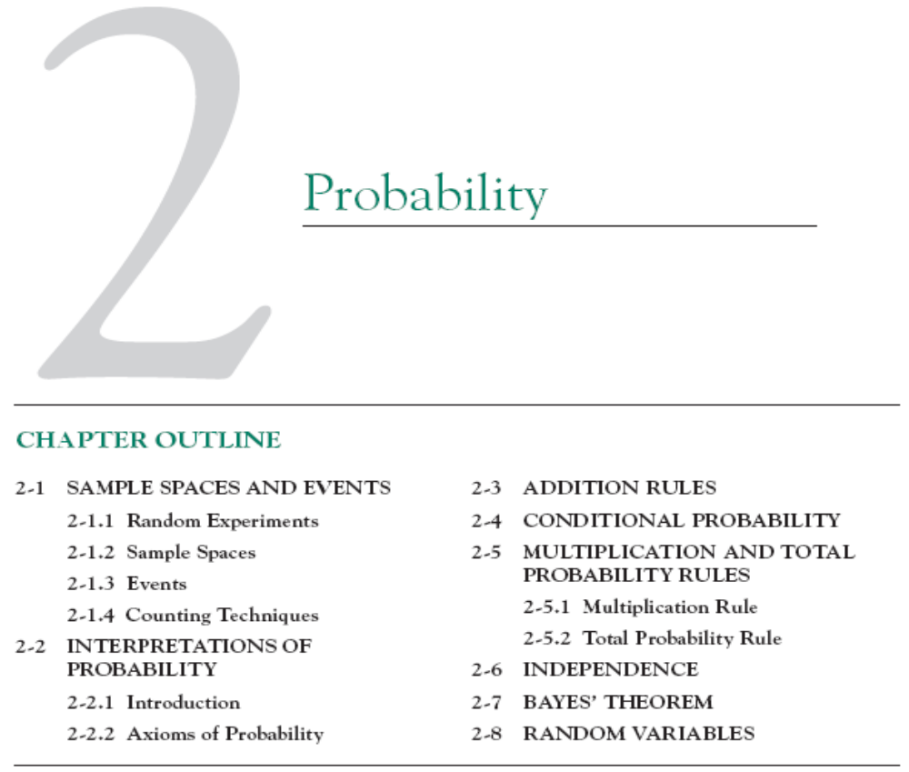

Slide 30
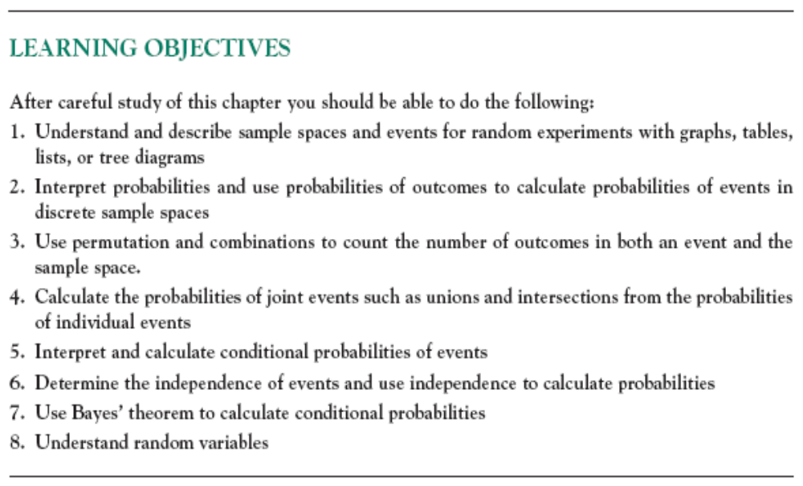

Slide 31
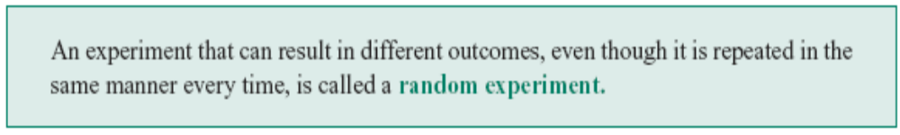
2-1 Sample Spaces and Events
2-1.1 Random Experiments
Definition

Slide 32
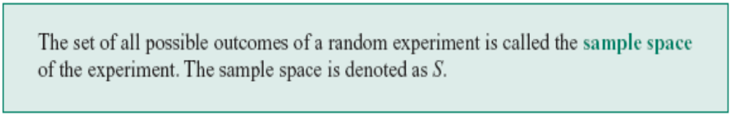
2-1 Sample Spaces and Events
2-1.2 Sample Spaces
Definition

Slide 33
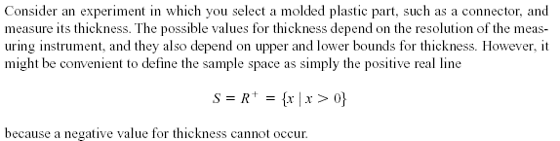
2-1 Sample Spaces and Events
2-1.2 Sample Spaces
Example 2-1

Slide 34
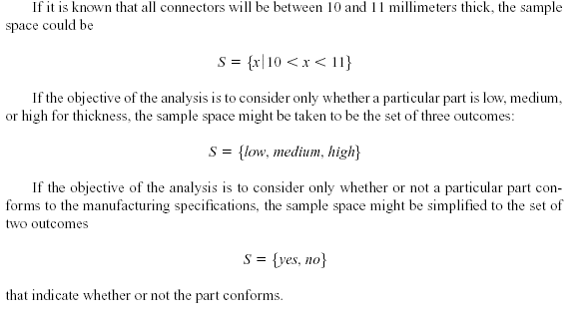
2-1 Sample Spaces and Events
Example 2-1 (continued)
Notes:
Conform: làm cho phù hợp với
Specification: đặc điểm kỹ thuật

Slide 35
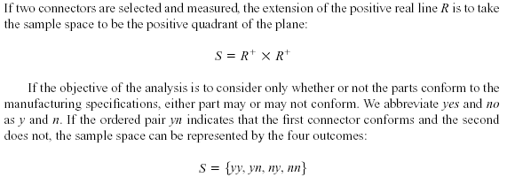
2-1 Sample Spaces and Events
Example 2-2
Notes:
Abbreviate: viết tắt

Slide 36
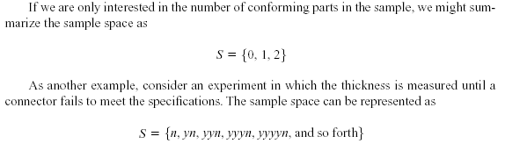
2-1 Sample Spaces and Events
Example 2-2 (continued)
Notes:
And so forth: và vân vân

Slide 37
2-1 Sample Spaces and Events
Tree Diagrams
Sample spaces can also be described graphically with tree diagrams.
  When a sample space can be constructed in several steps or stages, we can represent each of the n₁ ways of completing the first step as a branch of a tree.
  Each of the ways of completing the second step can be represented as n₂ branches starting from the ends of the original branches, and so forth.
Notes:
Stage: giai đoạn

Slide 38

2-1 Sample Spaces and Events
Example 2-3

Slide 39
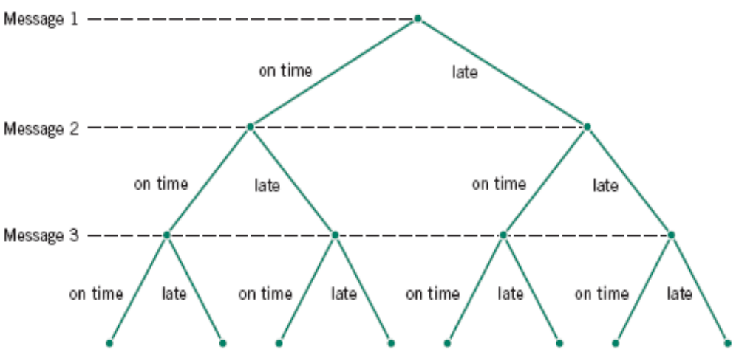
2-1 Sample Spaces and Events
Figure 2-5 Tree diagram for three messages.

Slide 40

2-1 Sample Spaces and Events
2-1.3 Events
Definition

Slide 41
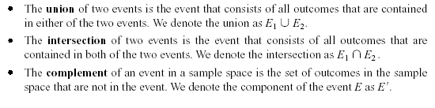
2-1 Sample Spaces and Events
2-1.3 Events
Basic Set Operations
Notes:
E’ = S \ E

Slide 42
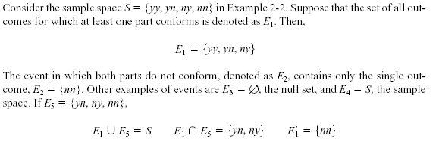
2-1 Sample Spaces and Events
2-1.3 Events
Example 2-6

Slide 43
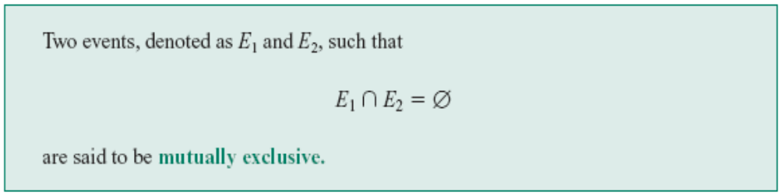
2-1 Sample Spaces and Events
Definition
Notes:
Exclusive: xung khắc
Mutually: lẫn nhau

Slide 44
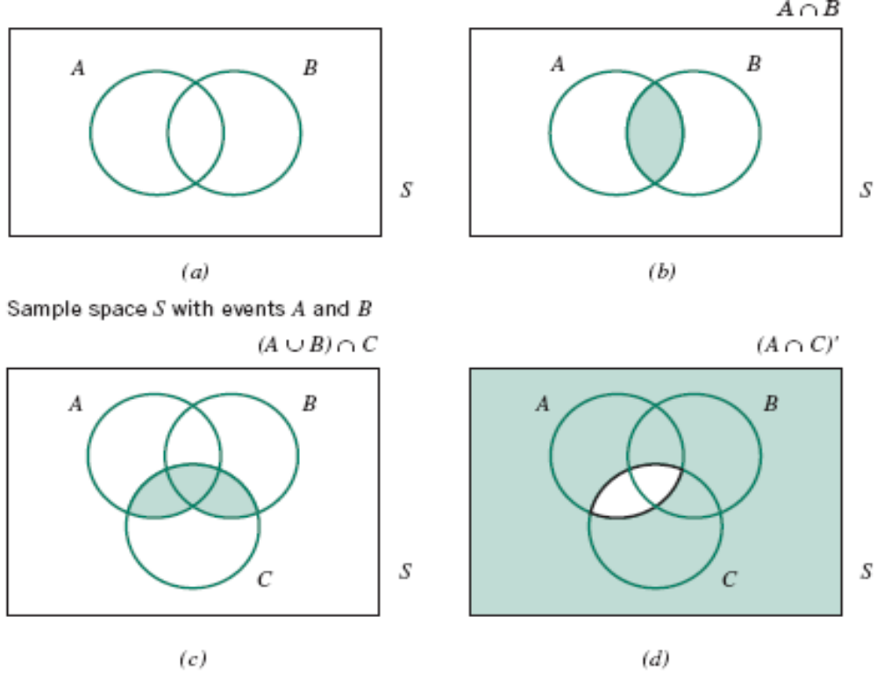
2-1 Sample Spaces and Events
Venn Diagrams
Figure 2-8 Venn diagrams.

Slide 45

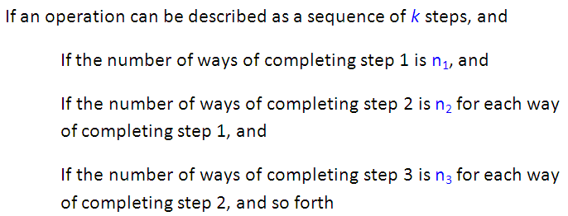

2.1.4 Counting Techniques

Slide 46

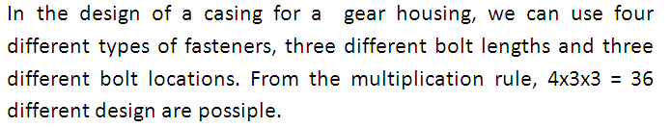

Slide 47

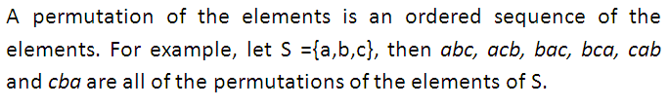

Slide 48




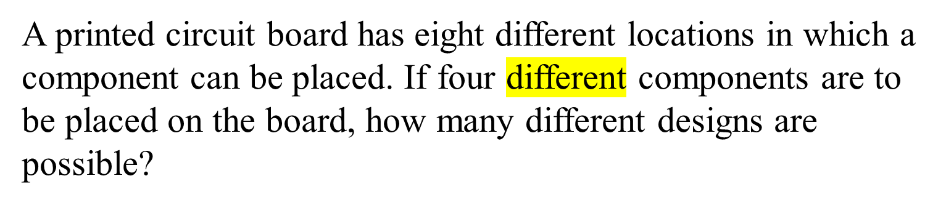

Slide 49
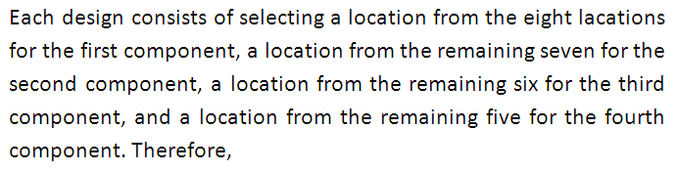


Slide 50

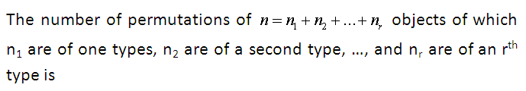


Slide 51

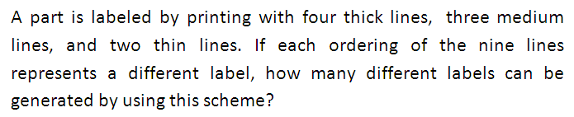


Slide 52

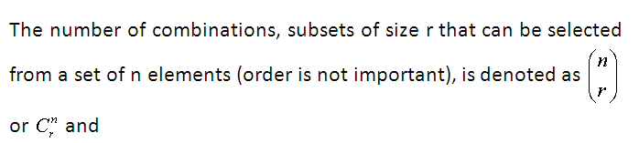


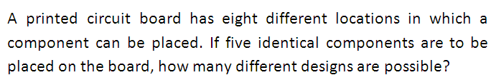

Slide 53



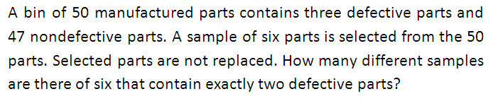


Notes:
p.48

